Slide 1
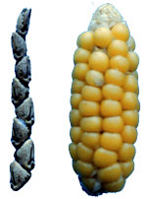
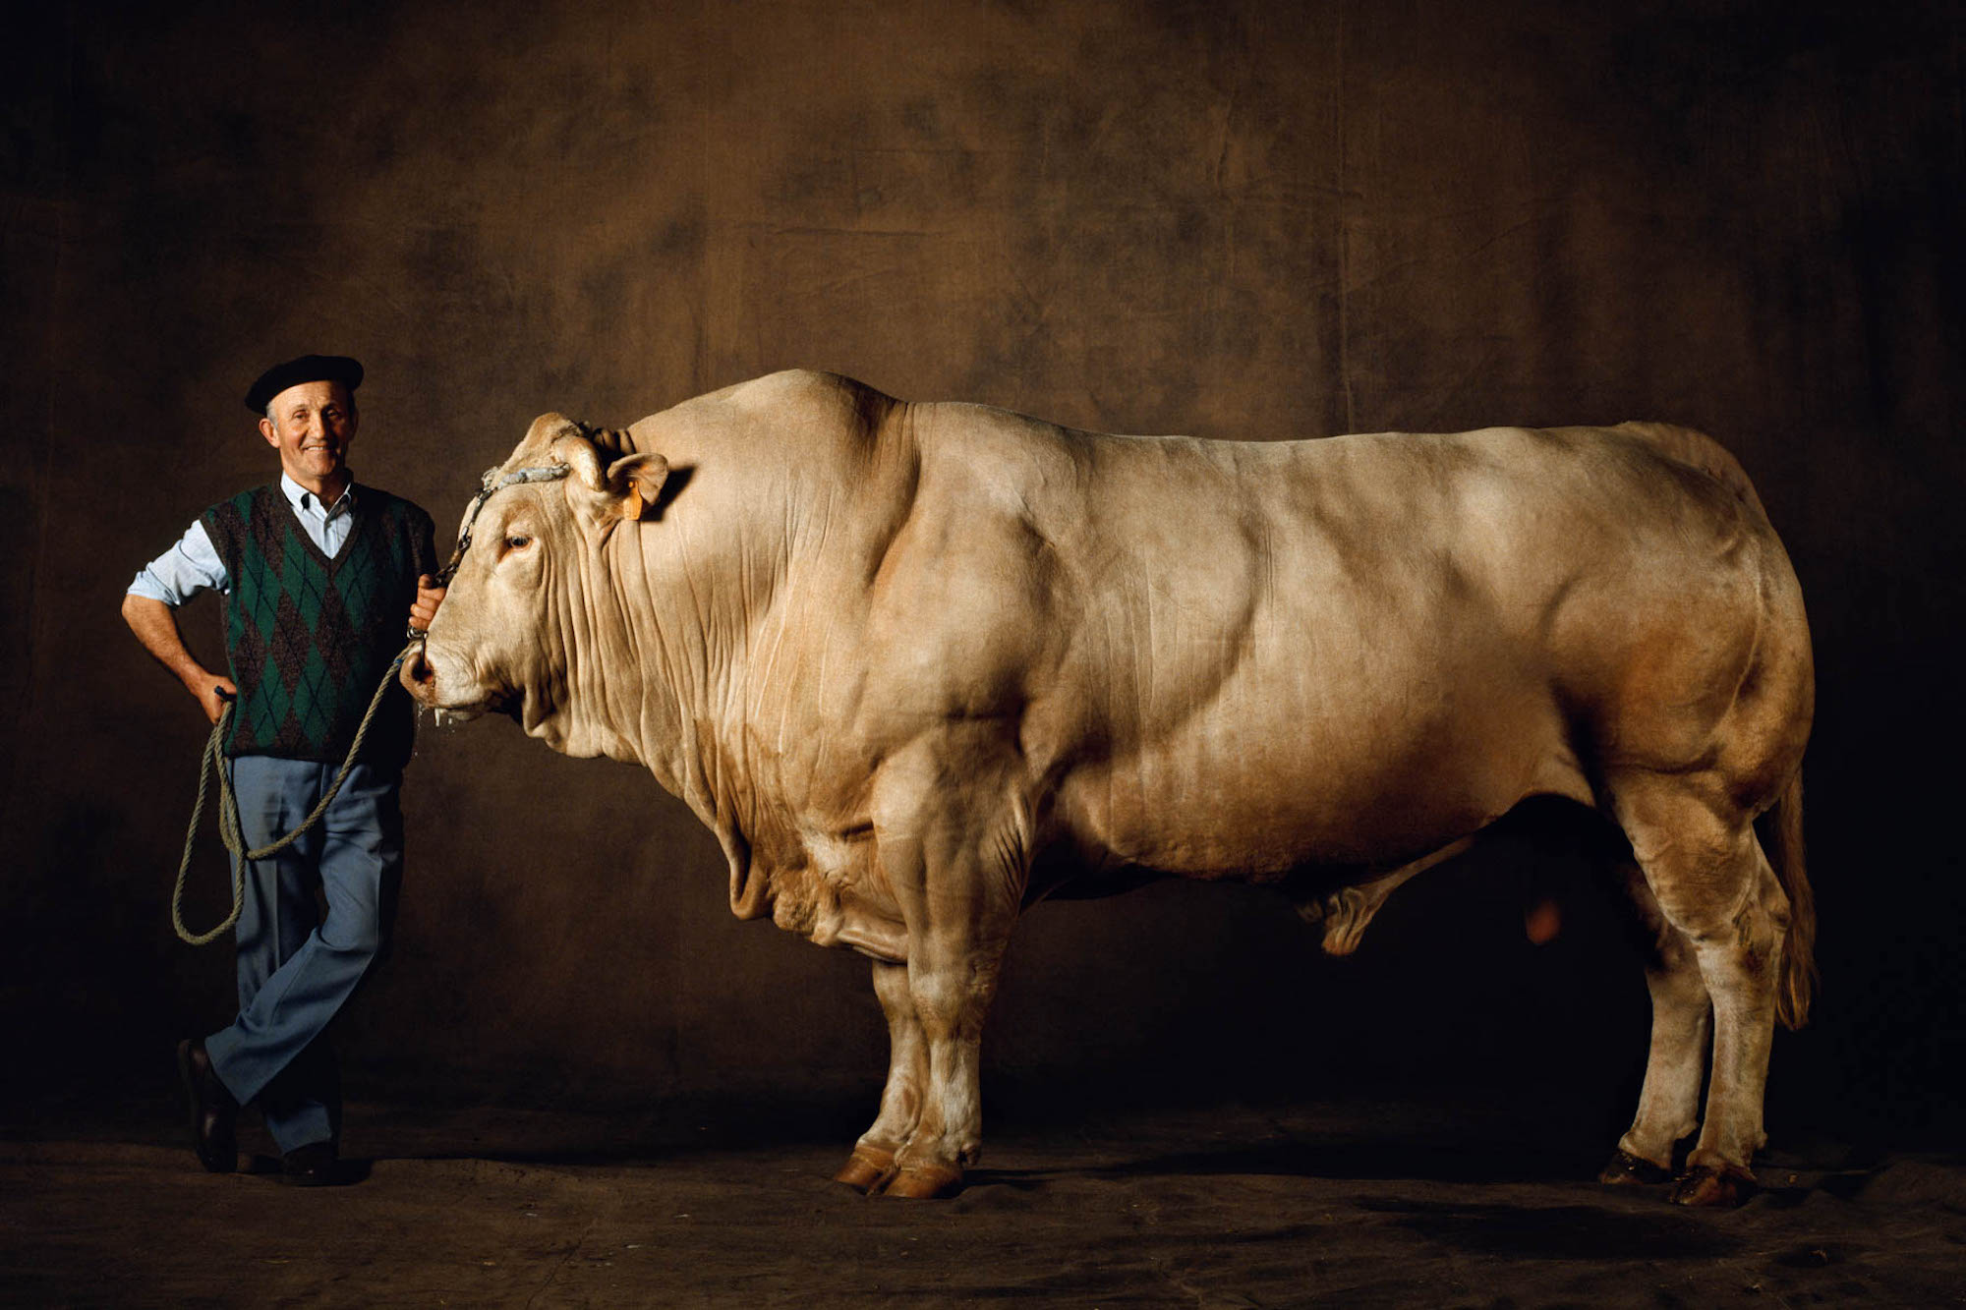
Artificial Selection
Science 10
Biology

Slide 2
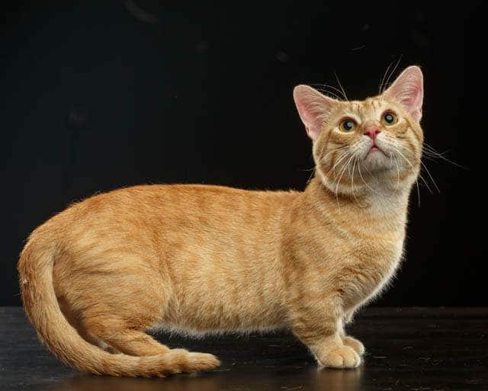
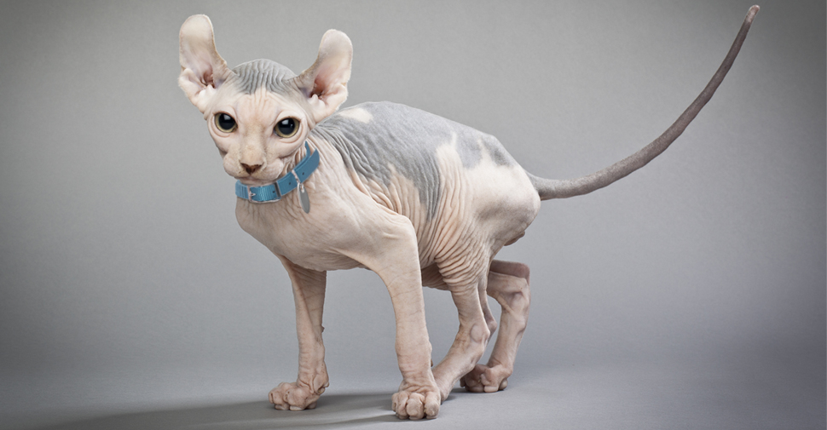
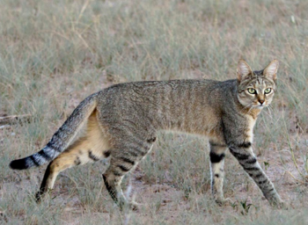
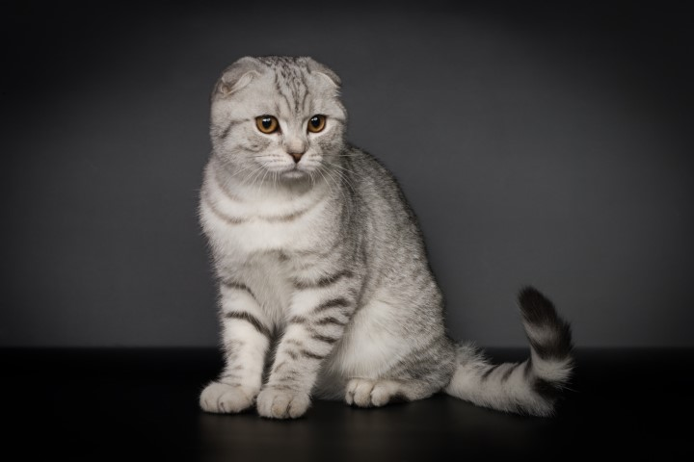
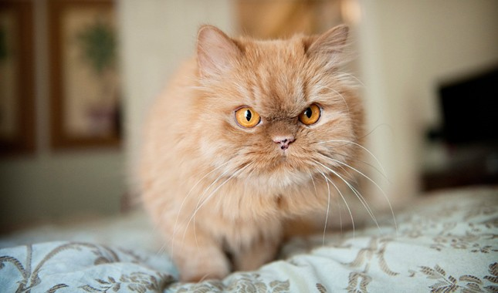
What is Artificial Selection?
Whenever a human exerts selective pressure on a population in order to improve or modify particular desirable traits
Sphynx
Munchkin
African wild cat
Persian
Scottish fold
Example: cats bread for appearance

Slide 3
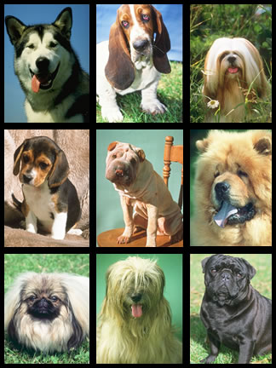
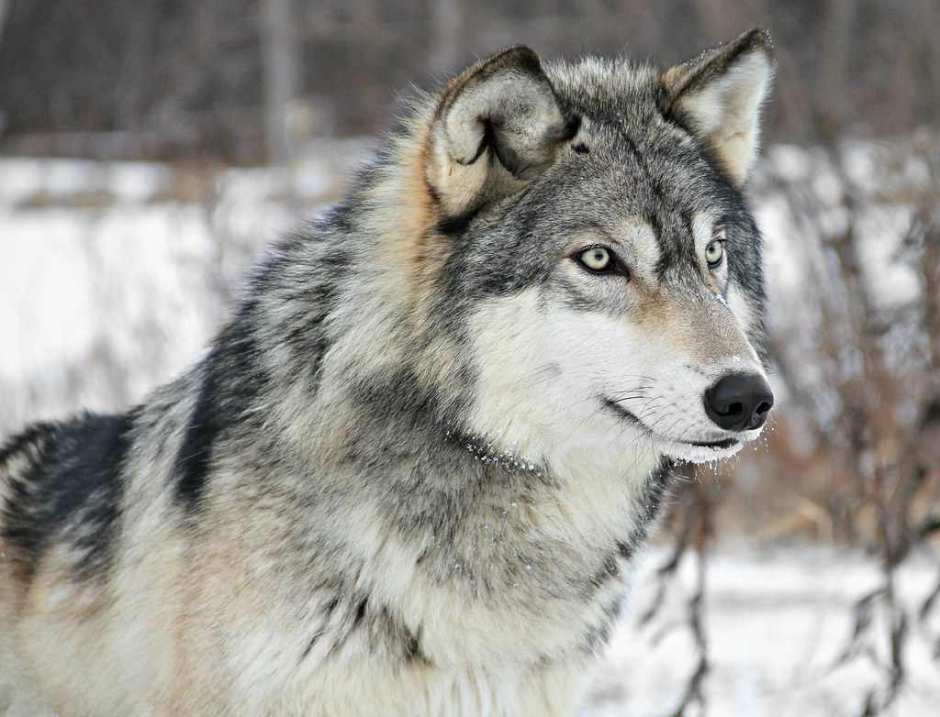
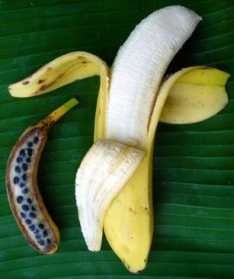
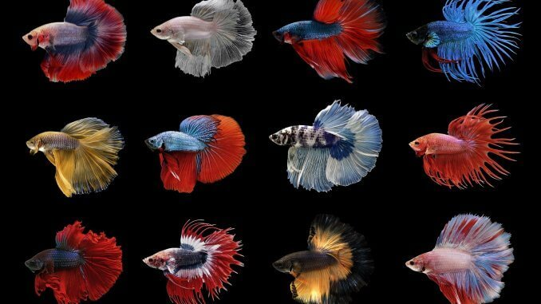
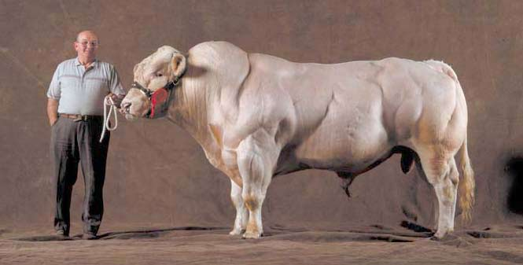
What is Artificial Selection?
Selectively breeding only those individuals that have desirable characteristics.
Humans have been selectively breeding plants and animals for thousands of years.
Plants: corn, rice, watermelon, wheat…
Animals: cows, dogs, sheep, chickens, fish…

Slide 4
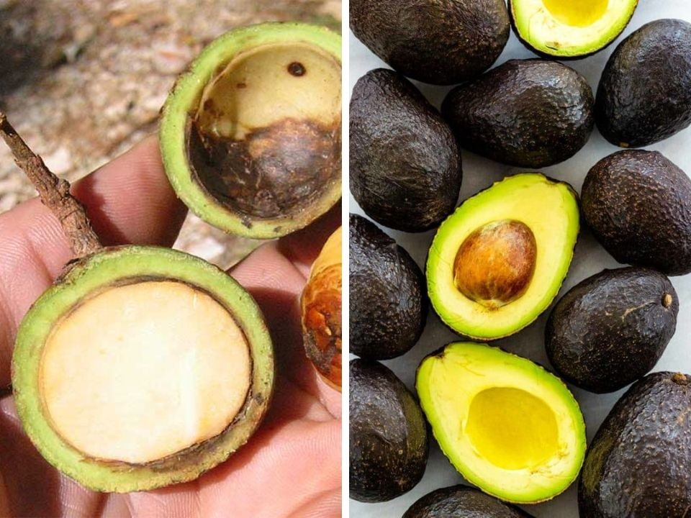
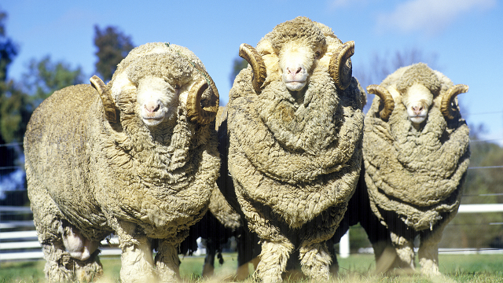
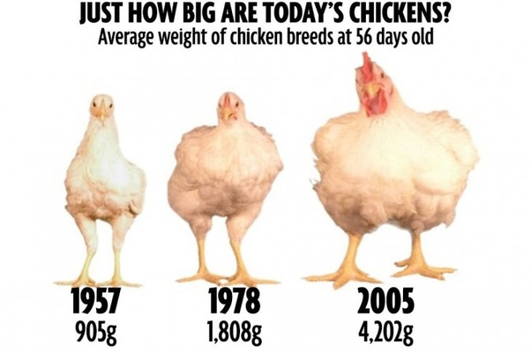
Artificial Selection and food crops
Some reasons why farmers selectively breed crops:
To increase nutritional value
To increase the production at harvest
To decrease time until harvest
To be drought-resistant or pest-resistant
To make animals more docile
Can you think of any more?
merino sheep
Notes:
Plants transport/ship better, disease resistant, make food more desirable (sweeter, better colour, bigger, softer, harder etc…)

Slide 5
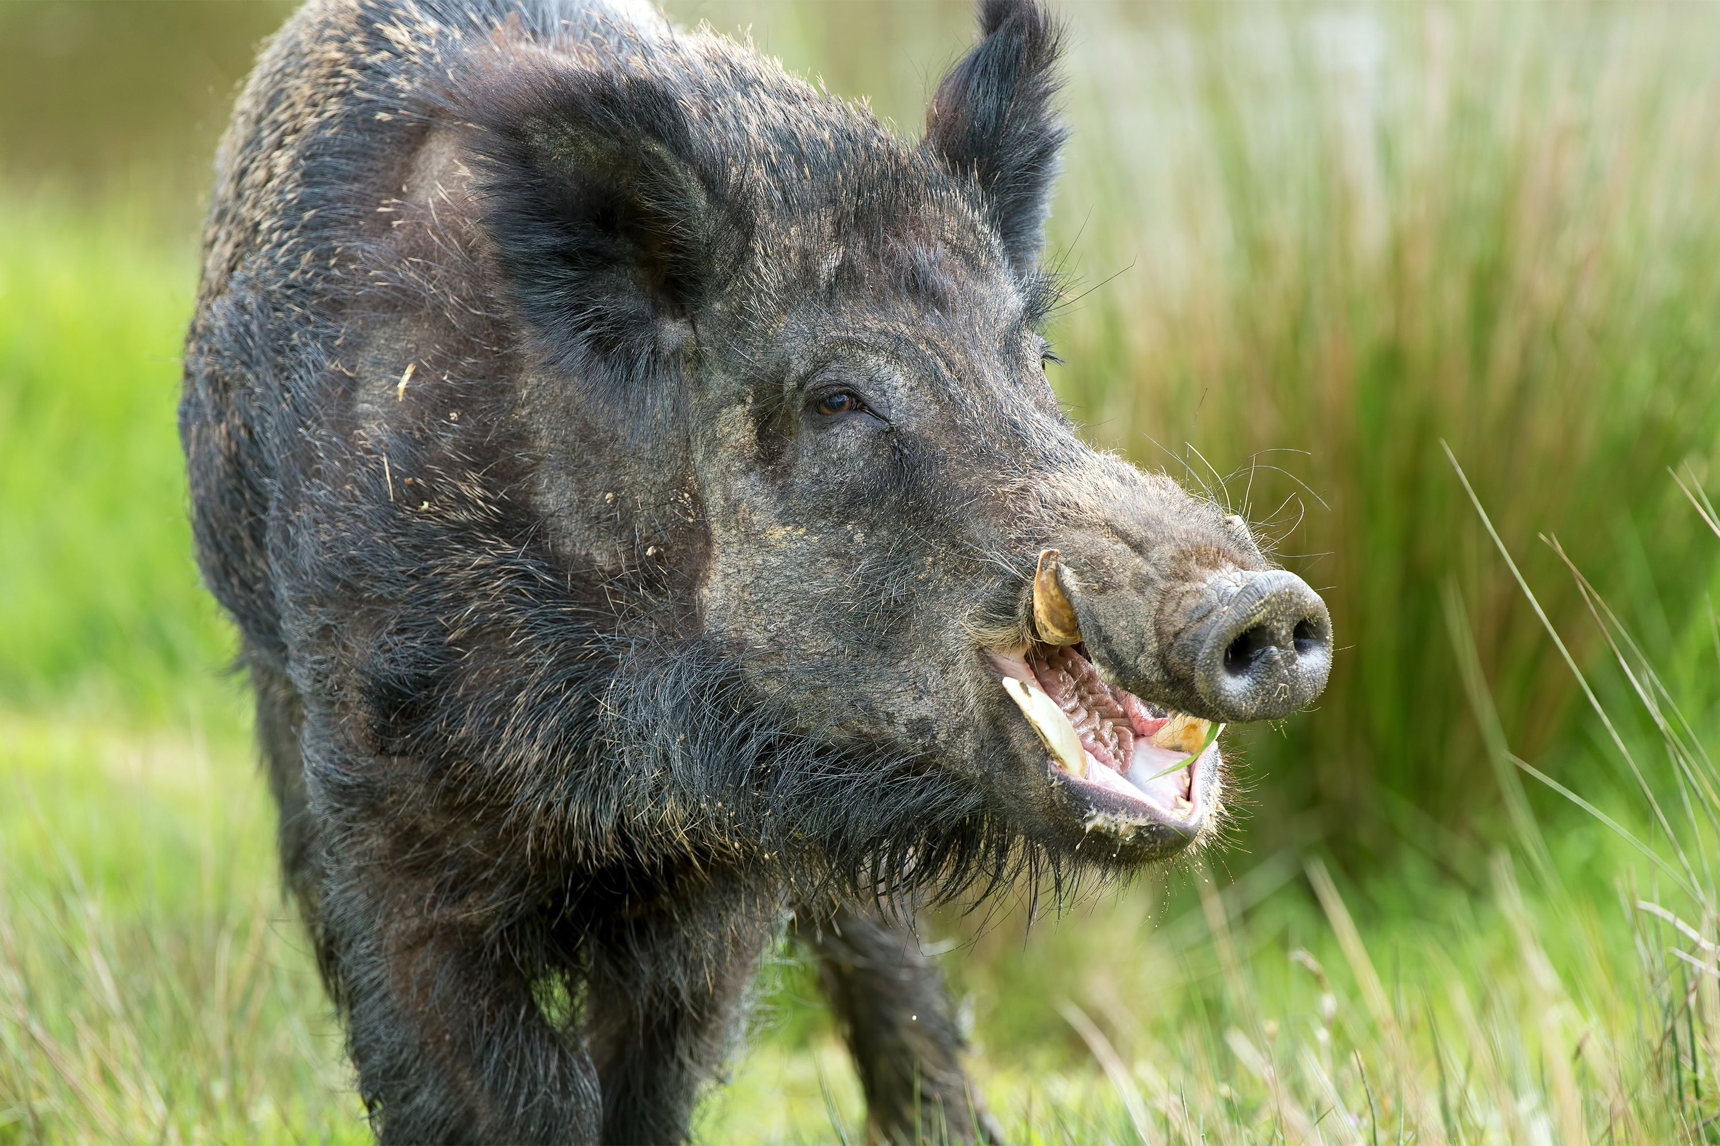
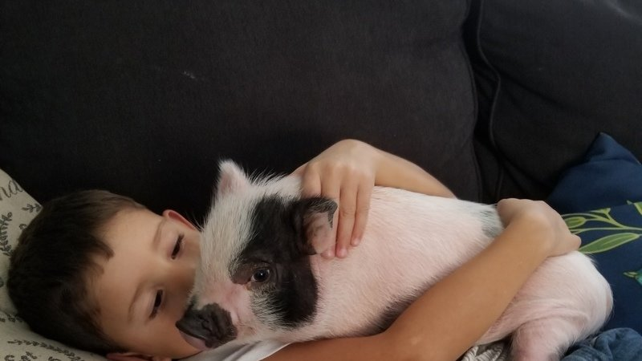
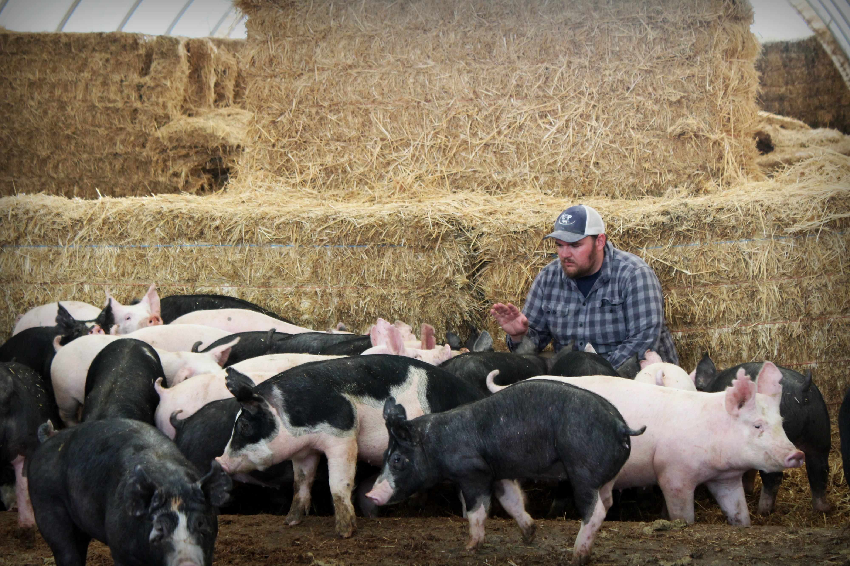
Natural selection vs artificial selection
Natural selection
Artificial selection
Process by which organisms that are best suited to their environment, have higher rates of survival and reproduction.
Process where humans exert selective pressure on a population in order to improve or modify particular desirable traits

Slide 6
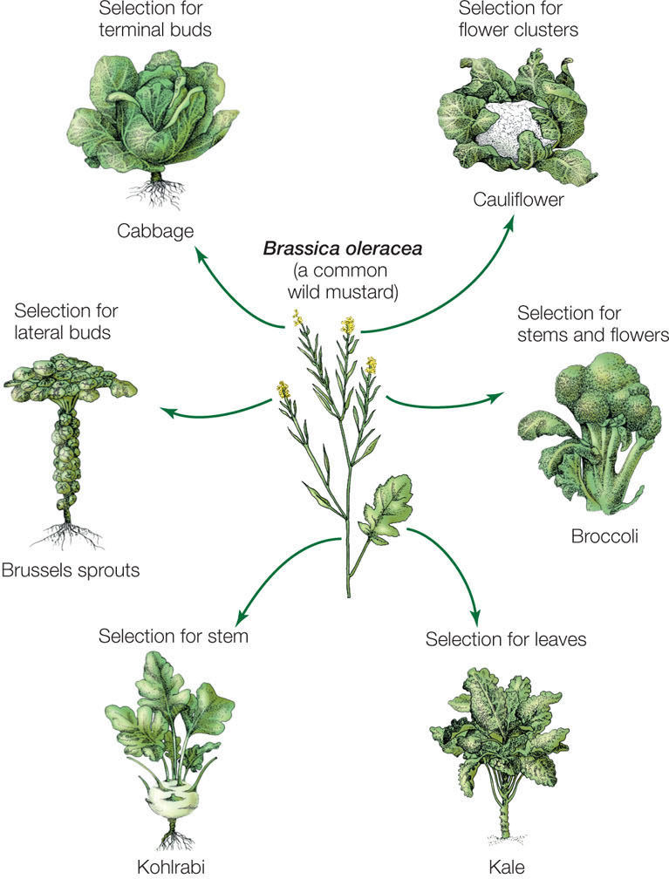
Artificial Selection
Over 2500 years farmers have cultivated numerous crops including broccoli, kale and cauliflower from wild mustard
Although they are the same species, these various crops are cultivars - different varieties bred to have desirable qualities for human purposes

Slide 7
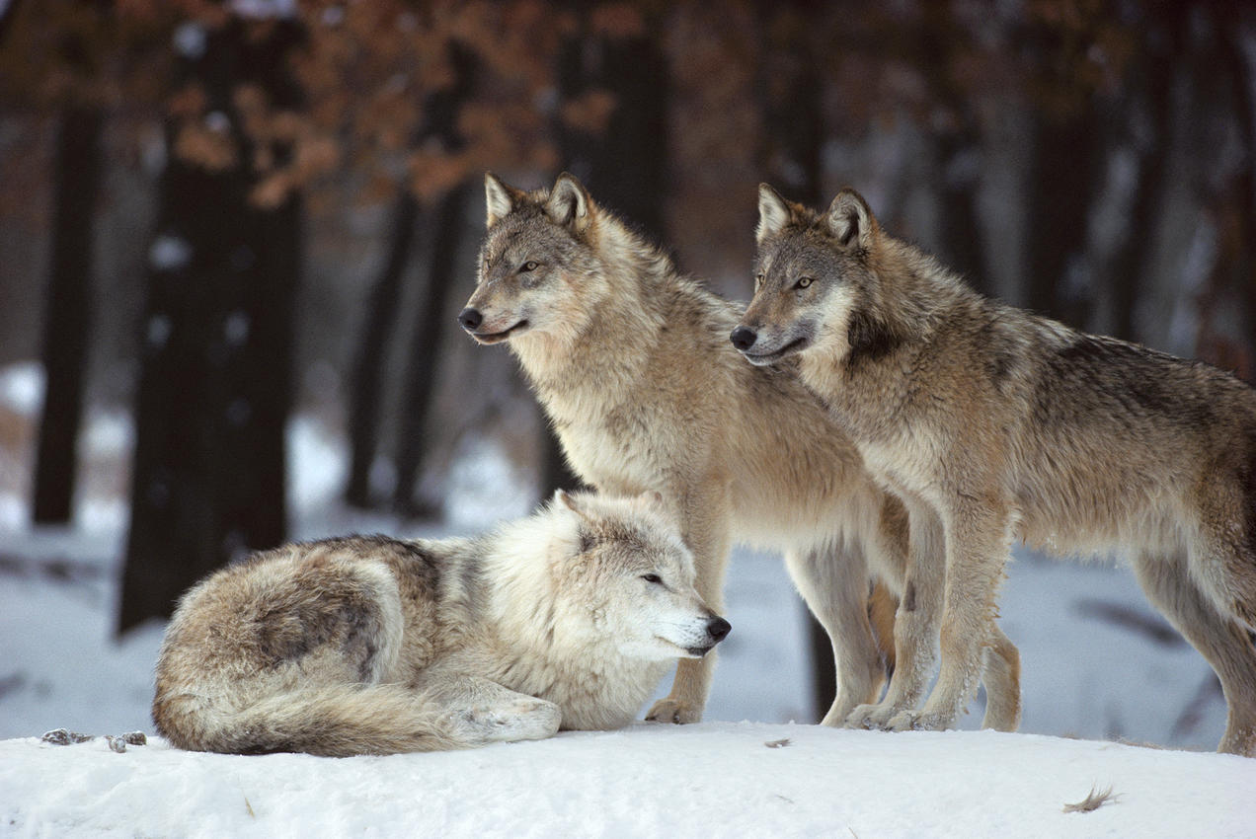
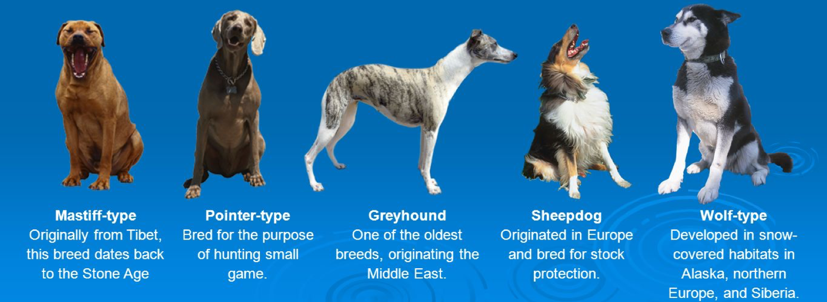
Dog Breeds
Dogs have been selectively bread over 15,000 years
Starting from wolves, dogs were initially bread to hunt
Hunting: producing hounds, terriers and retrievers
Farming: producing guard dogs and herd dogs

Slide 8
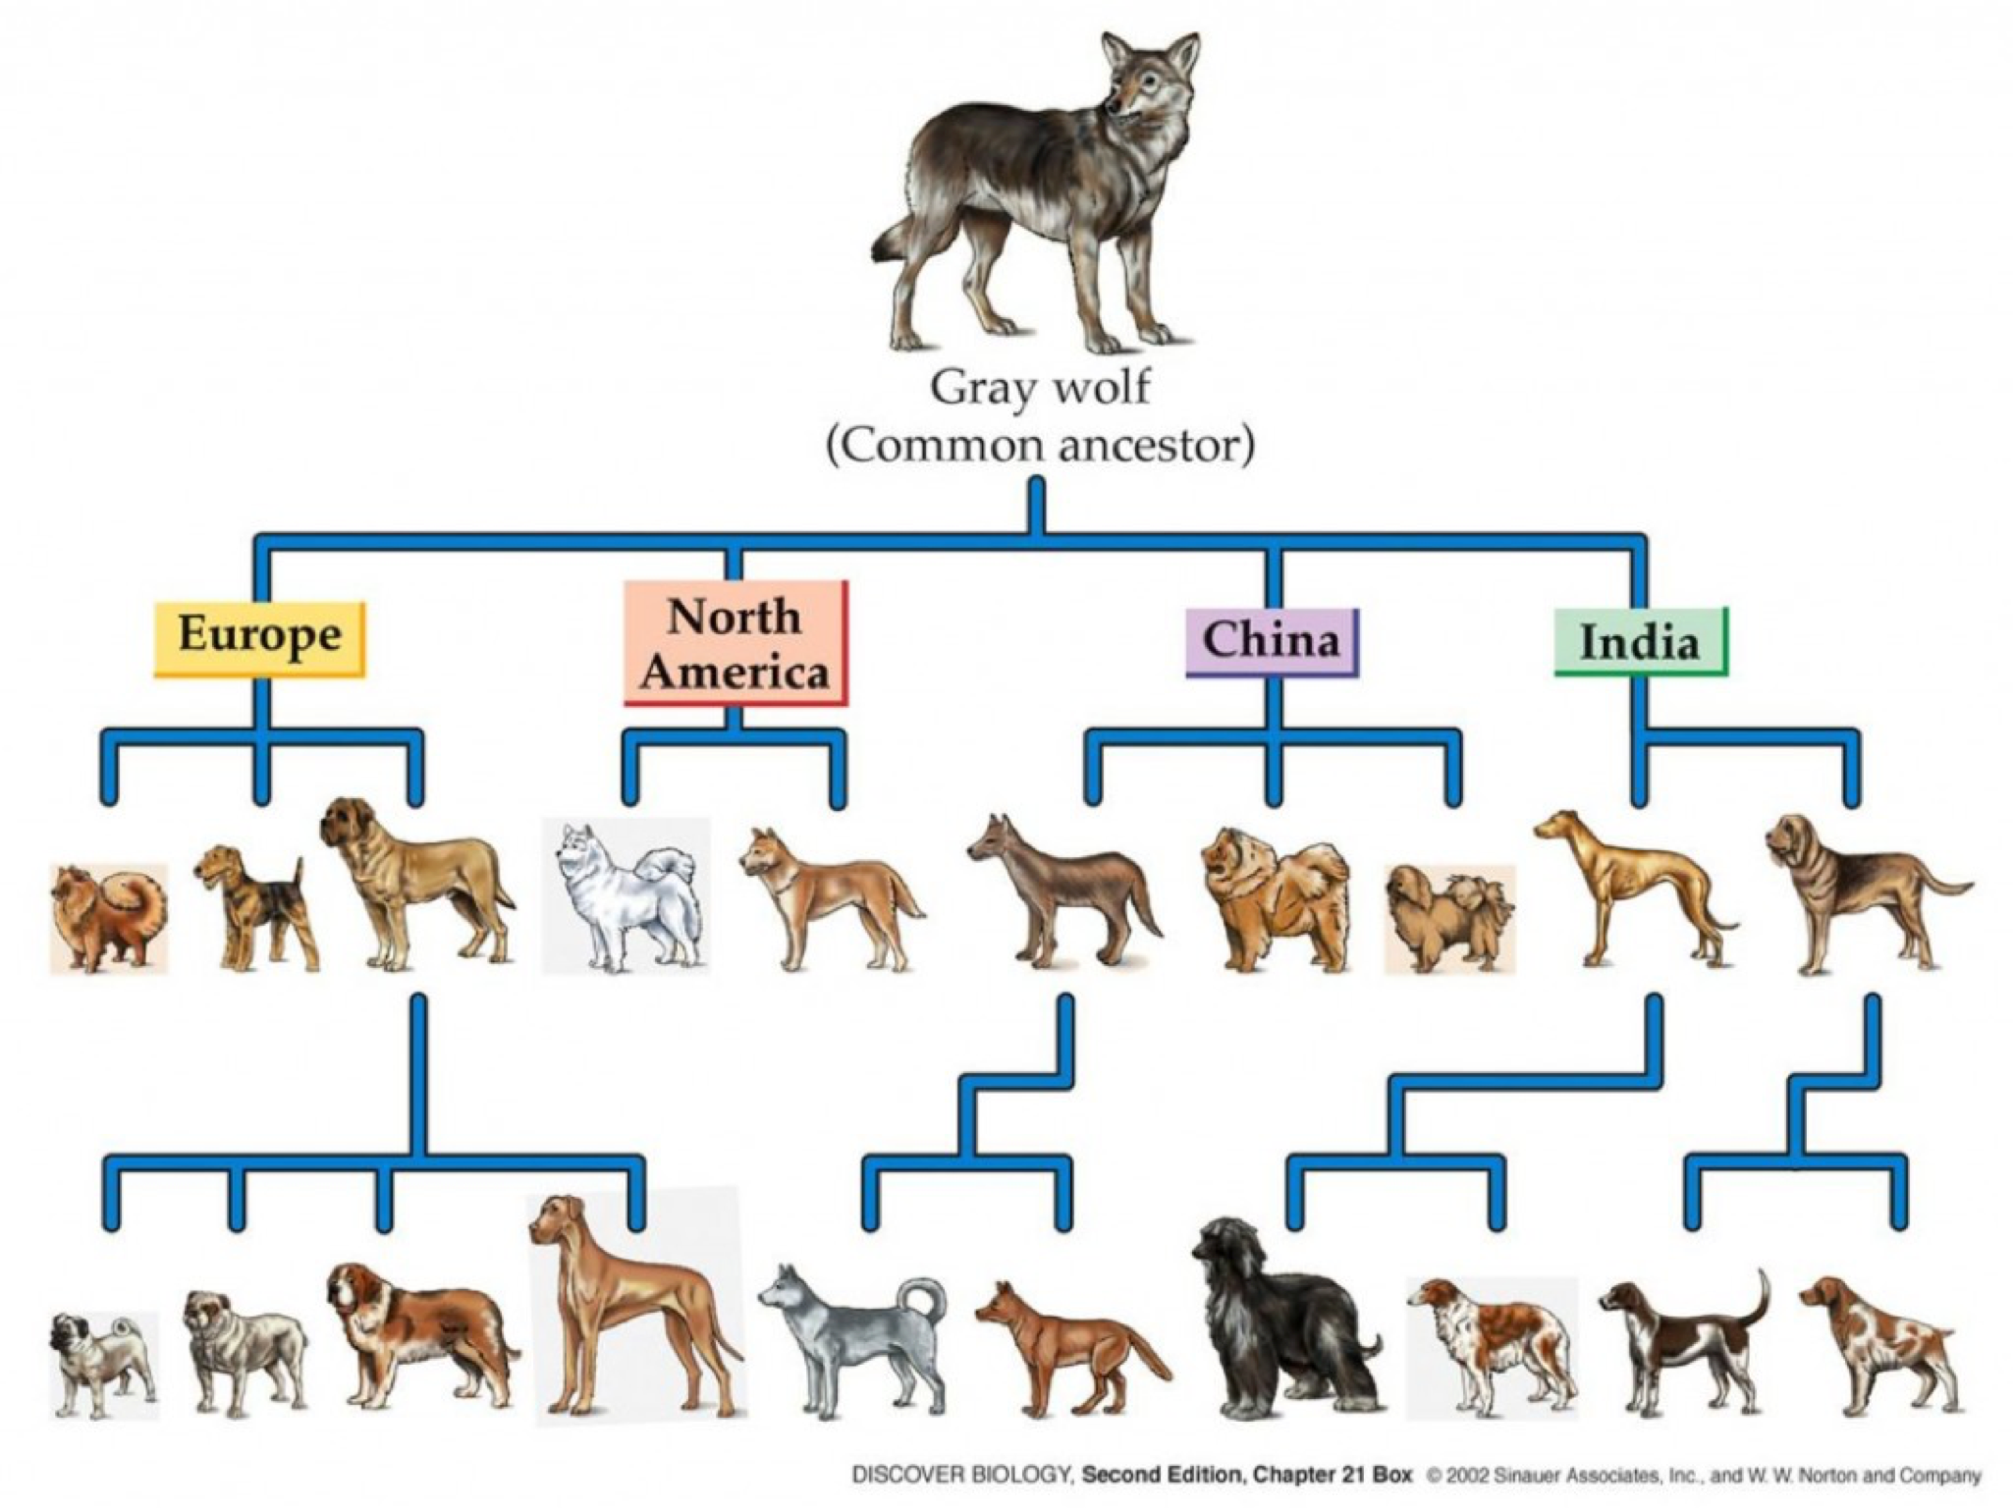

Slide 9
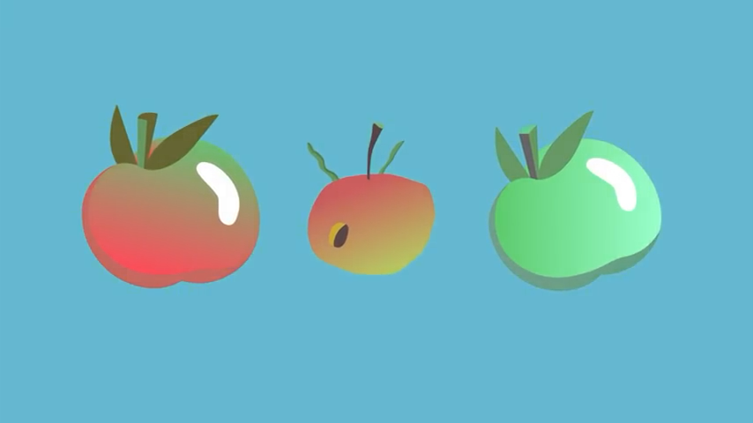
Why are there so many apples?

Slide 10
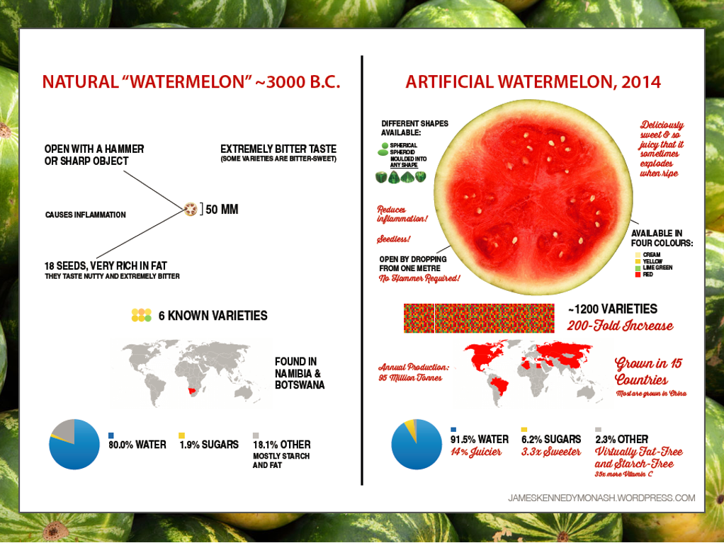

Slide 11
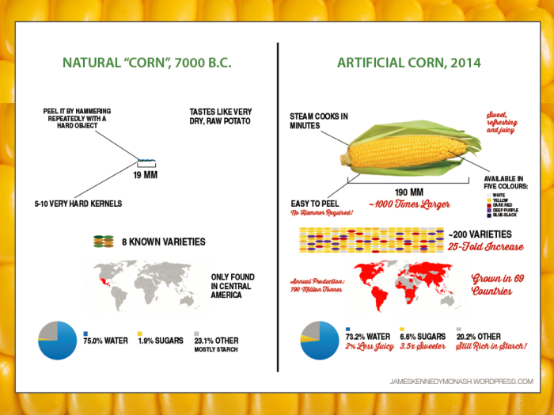

Slide 12
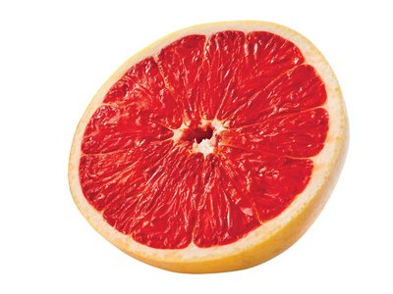
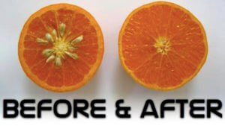
Radiation Mutagenesis
Before transgenics if a desired trait wasn’t present in nature, mutations were induced using radiation mutagenesis
More than 2500 plant varieties (including rice, grapefruit, lettuce) were developed using this method
In the 1800’s the pale seed filled grapefruit was described as being“thick skinned and worthless”
The“Rio Red” & “Star Ruby”grapefruit were developed 1971 & 1985 and now make up 75% of Texas’s grapefruit crop
Notes:
What if the desired traits aren’t present in the wild type of the organism?

Slide 13
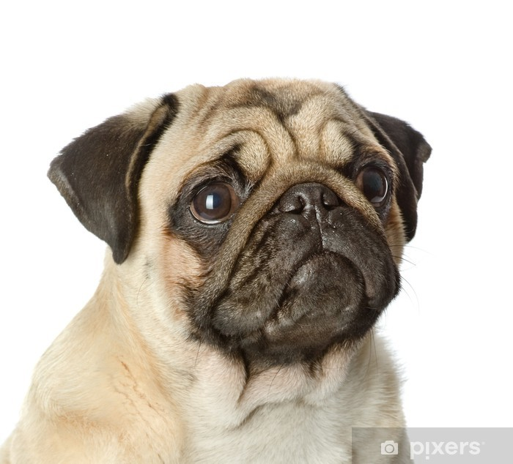
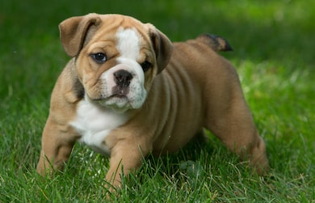
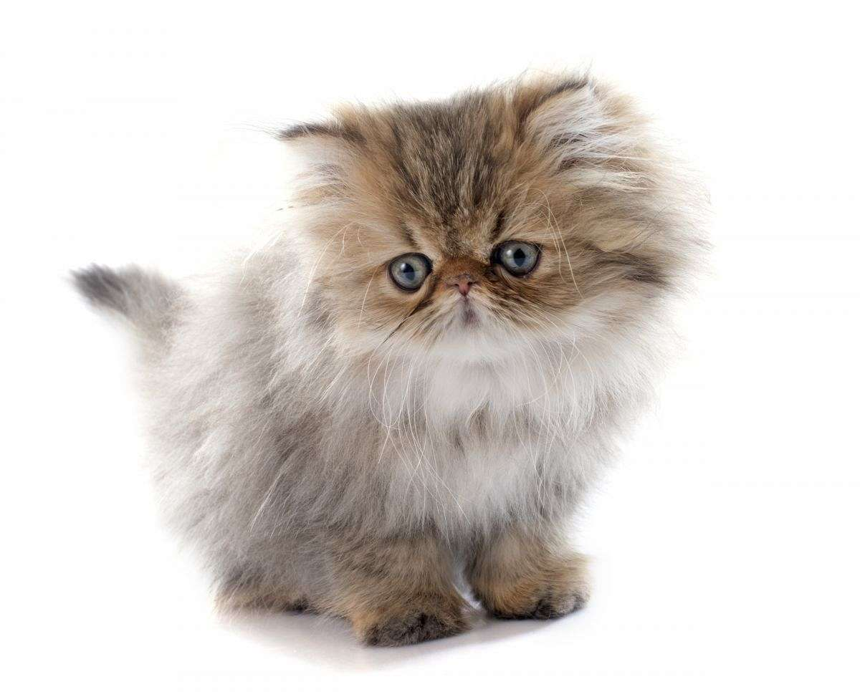
Consequences of Artificial Selection
In breeding organisms to exhibit one particularly desirable trait to humans, it may result in a negative impact on the target organism.
Example. breeding bulldogs, pugs or Persian cats to have flat faces (a desirable physical feature for pet breeders/owners) results in respiratory difficulties in these animals.
Pug
English bulldog
Persian

Slide 14
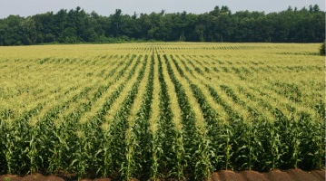
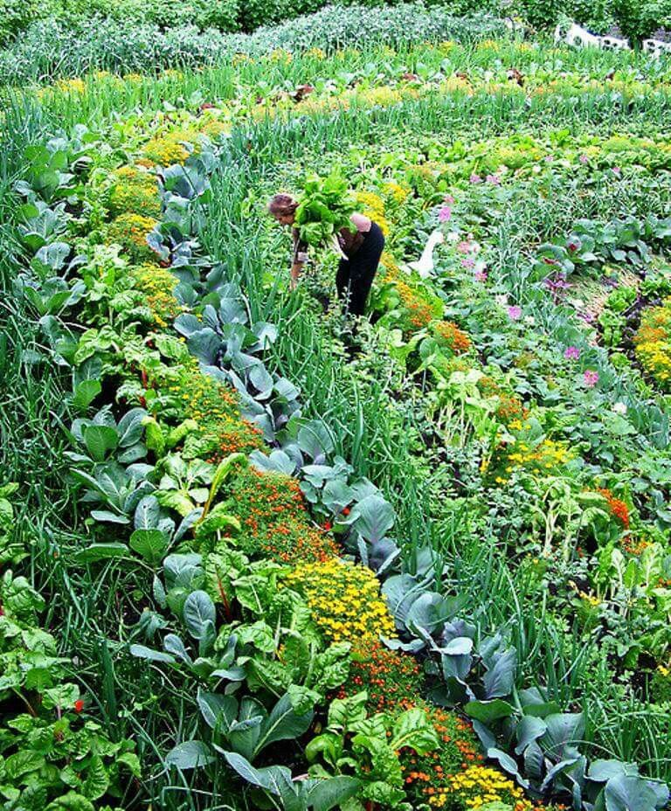
Consequences of Artificial Selection
One of the goals of artificial selection is uniformity. This reduces genetic diversity in the population.
Agricultural practices often involve propagation of the same varieties of species over large areas. This is known as a monoculture. This makes the area easier to manage for farmers, but it comes with significant risk.
monoculture
polyculture

Slide 15
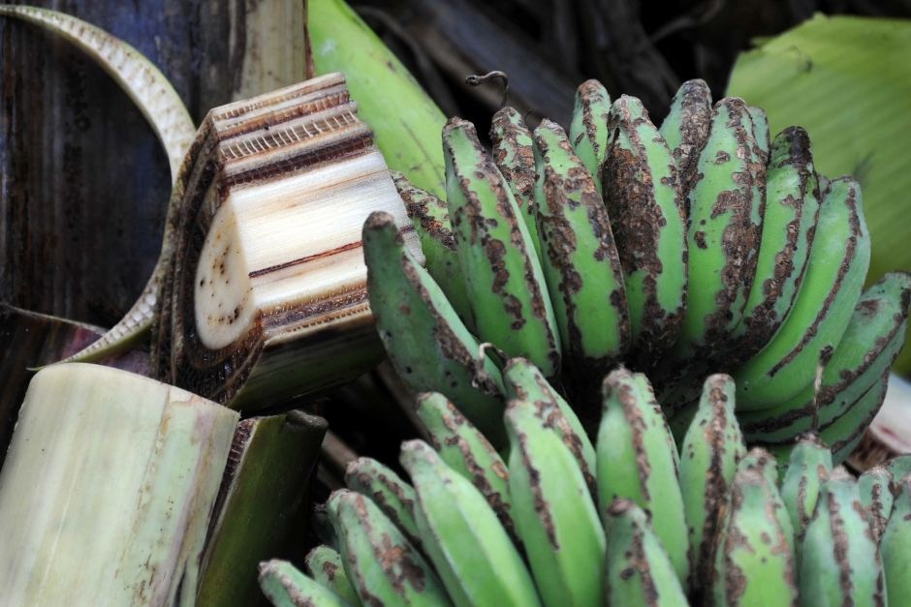
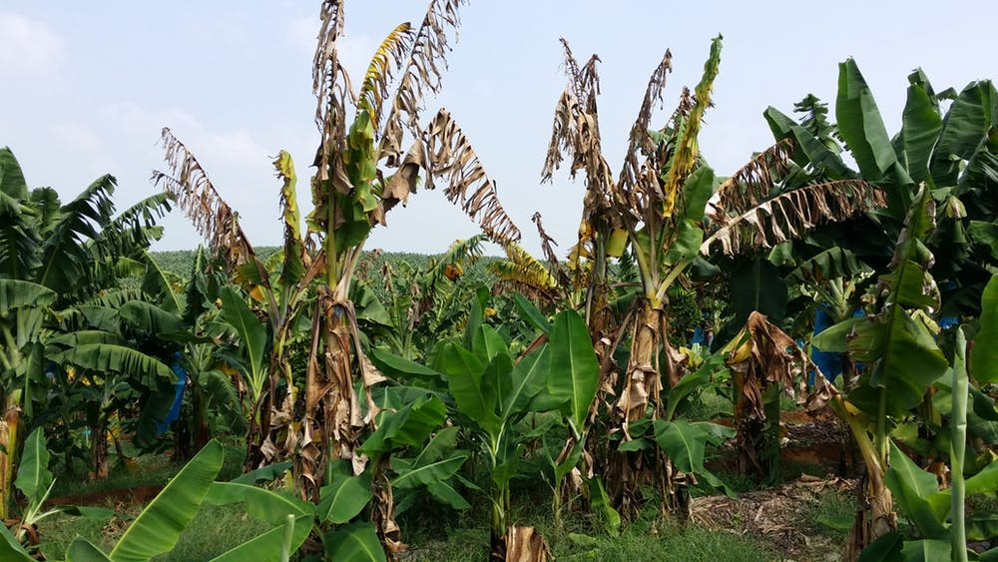
Consequences of Artificial Selection
Since all the organisms are similar, environmental changes or disease will affect most of the individuals in the same way. As a result the entire population/crop could be wiped out or severely damaged.

Slide 16
Consequences of Artificial Selection
To prevent the loss of genetic diversity, gene banks (sometimes referred to as doomsday vaults) have been established around the world.
Gene banks are a bio repository to preserve genetic material.
For animals, this means freezing sperm and eggs.
For plants, this could be in vitro storage, freezing cuttings or stocking seeds.

Slide 17
Consequences of Artificial Selection
Seed banks have been established that contain populations of early ancestors to many modern plants. This maintains genetic combinations that have been selected against by farmers, but prevents genetic diversity from being lost.
Many specimens have been collected from farmers growing heirloom varieties, the wild, and from prehistoric archeological sites.
Svalbard Global Seed Vault.

Slide 18
Assignments
Read p. 17-18, 47-57
Complete Workbook Ch 1.3
Artificial Selection WS
Youtube search “Selective Breeding | Biology for All | FuseSchool”
Answer all questions on the sheet

